Slide 1
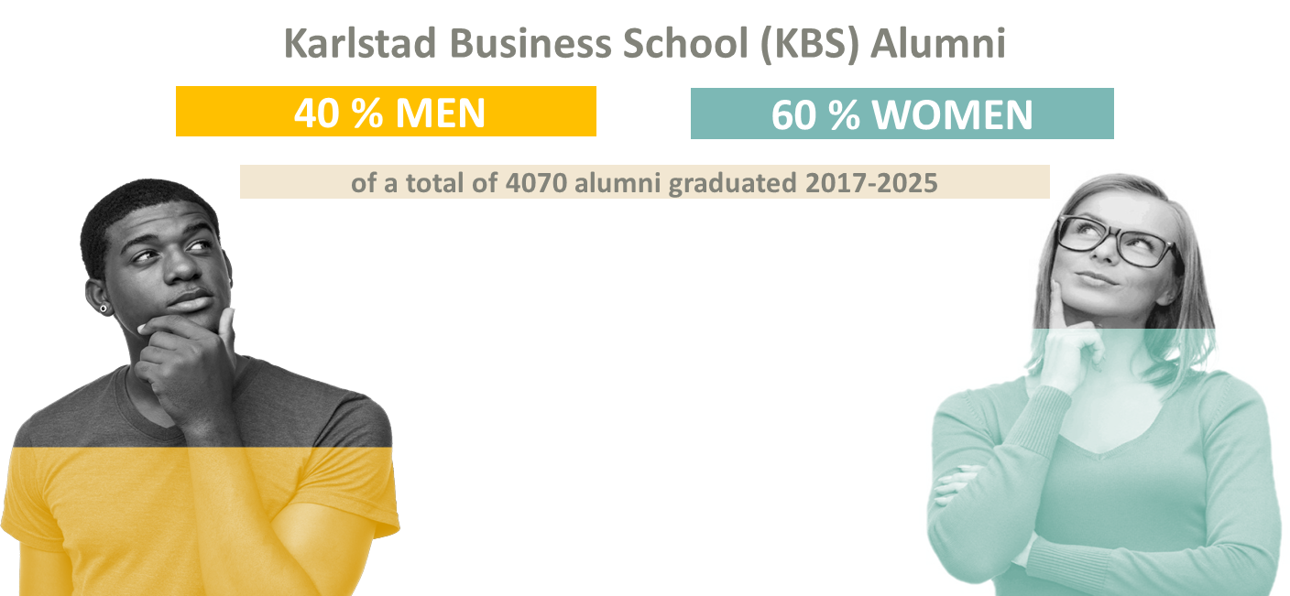

Slide 2
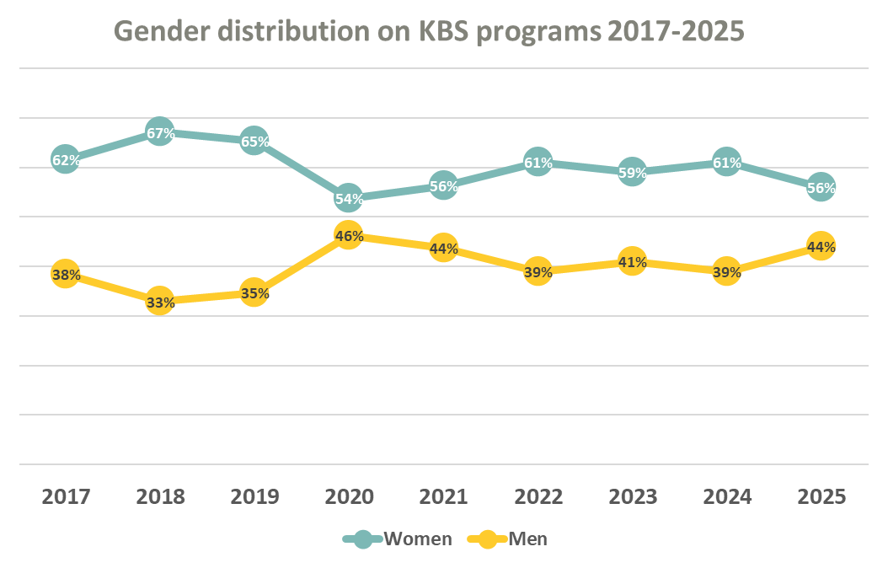

Slide 3
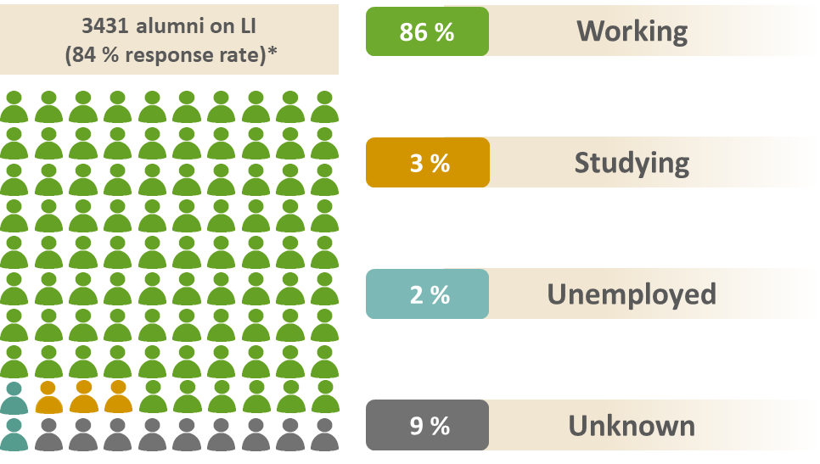
* 2017 and 2018 measured spring 2020
2019 measured spring 2021
2020 and 2021 measured spring 2022
2022 measured spring 2024
2023 measured spring 2025
2024 and 2025 measured spring 2026

Slide 4
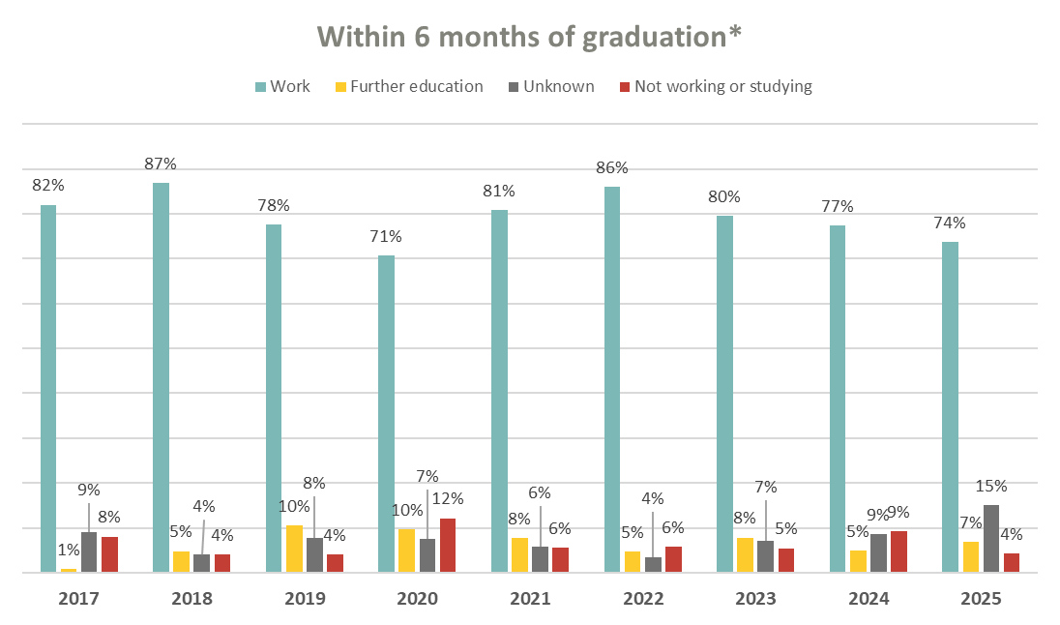
*384 alumni 2017 and 291 alumni 2018, present on LI in April 2020.
344 alumni 2019, present on LI in April 2021.
362 alumni 2020 and 358 alumni 2021, present on LI in May 2022.
414 alumni 2022, present on LI in May 2024.
417 alumni 2023 present on LI in May 2025,
468 alumni 2024, and 393 alumni 2025 present on LI in May 2026.

Slide 5
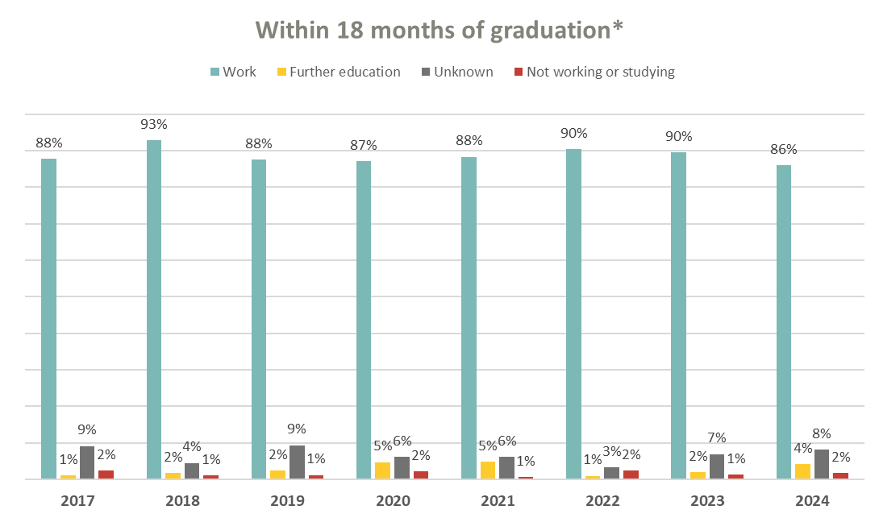
*384 alumni 2017 and 291 alumni 2018, present on LI in April 2020.
344 alumni 2019, present on LI in April 2021.
362 alumni 2020 and 358 alumni 2021, present on LI in May 2022.
414 alumni 2022, present on LI in May 2024.
417 alumni 2023 present on LI in May 2025,
468 alumni 2024 present on LI in May 2026.

Slide 6
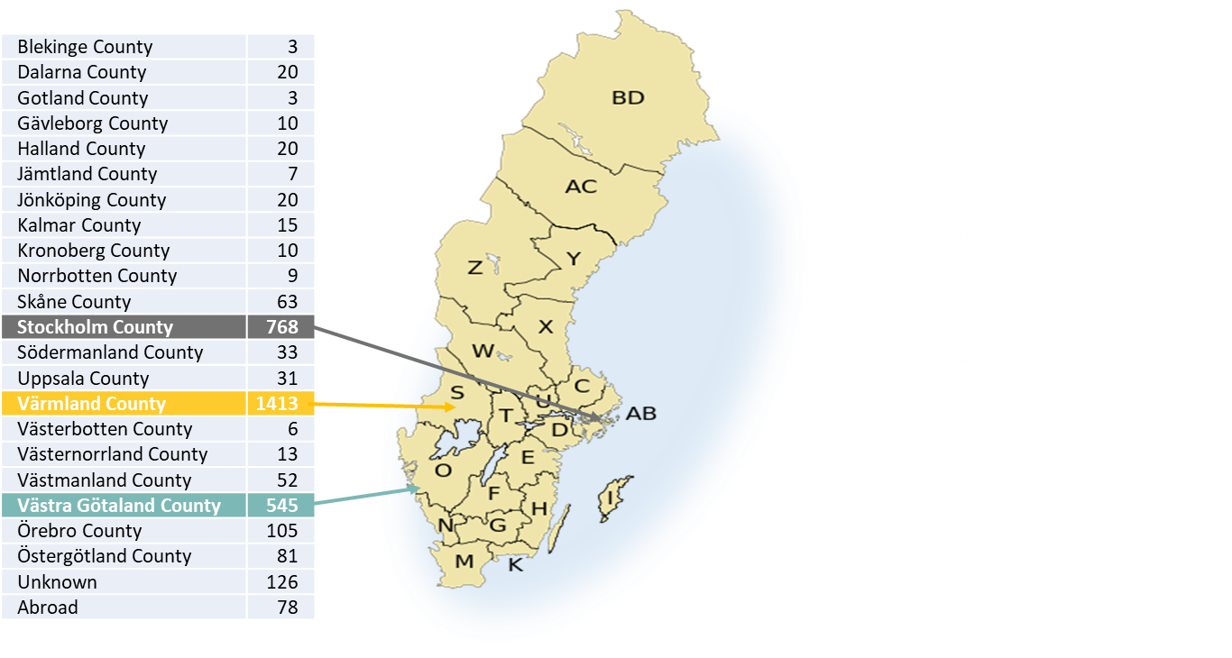

Slide 7
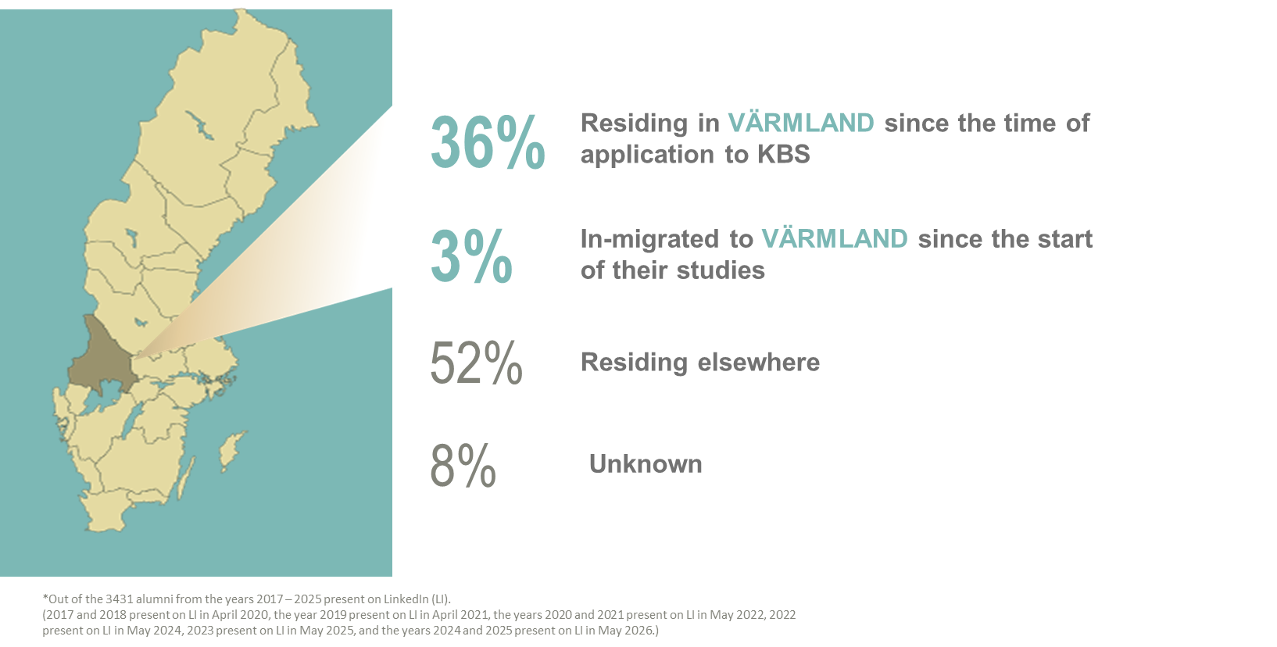

Slide 8
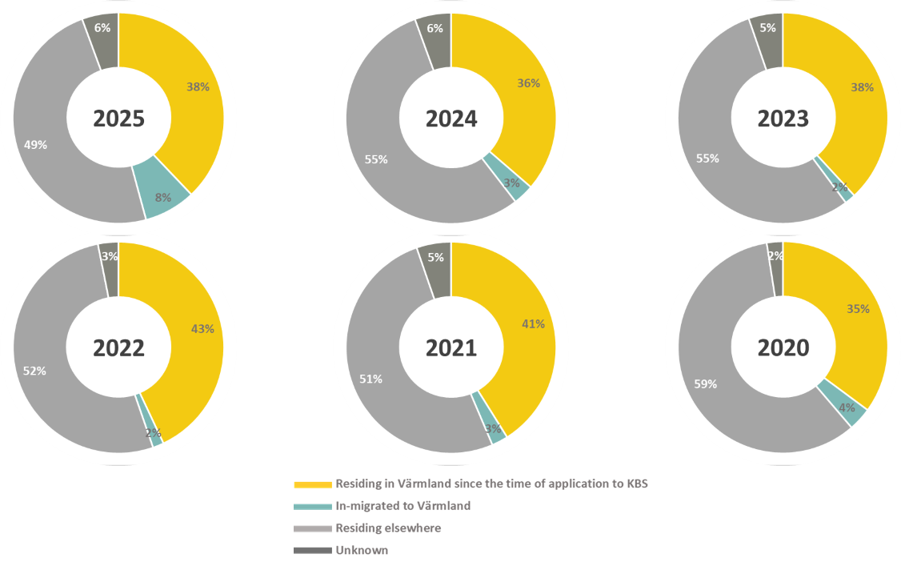

Slide 9
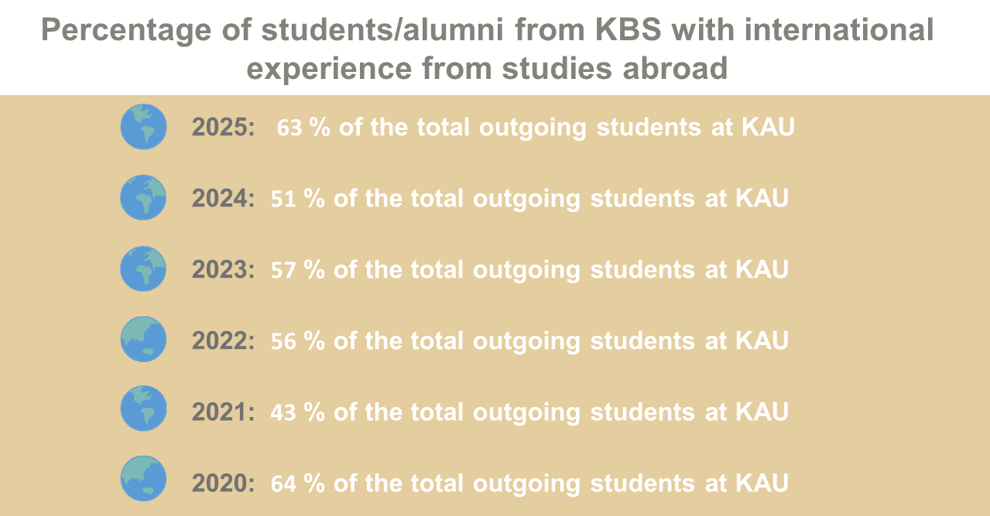

Slide 10
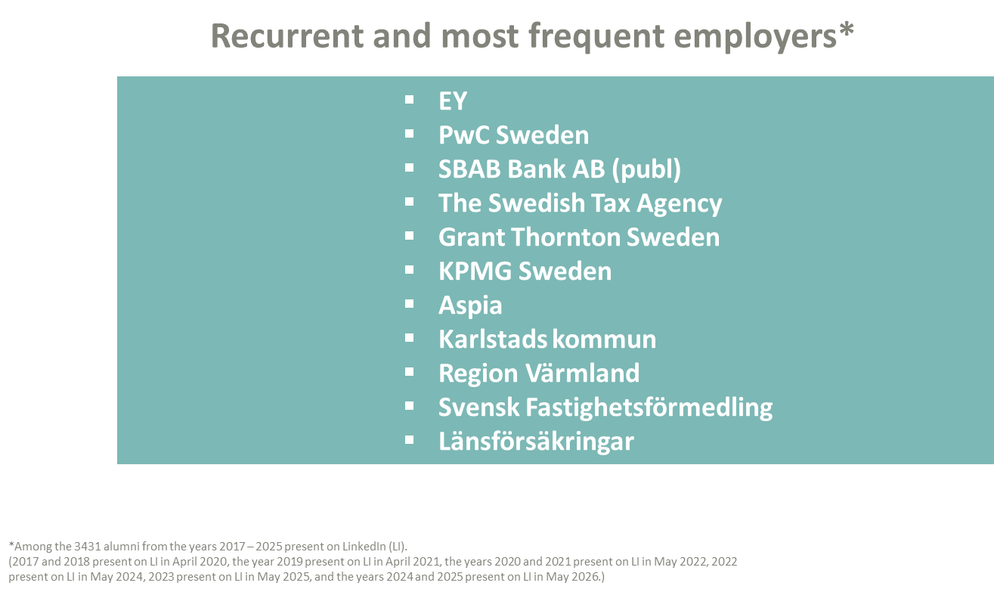

Slide 11
