Slide 1

MENTAL HEALTH PROBLEMS AMONG SWEDISH ADOLESCENTS
Time trend in mental health in light of economic and social-relation factors¹ and mental health today in light of physical activity²
¹ Yunhwan Kim
²Li Ma
Centre for Research on Child and Adolescent Mental Health
Open Seminar: Meet a researcher
September 24th 2019

Slide 2
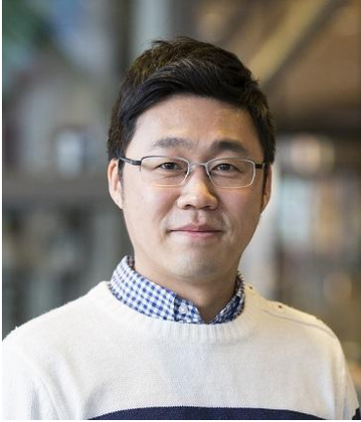
Education
2008 M.A. Child Development, Yonsei University, South Korea
2012 Ph.D. Human Development, Ohio State University, USA
Work
2012-2015 Örebro University
2016- Karlstad University
Research Interest
Positive Development among Children and Youth
: Mental Health
: Civic/Political Development
: Education in the Internet era
Open Seminar: Meet a researcher
September 24th 2019

Slide 3
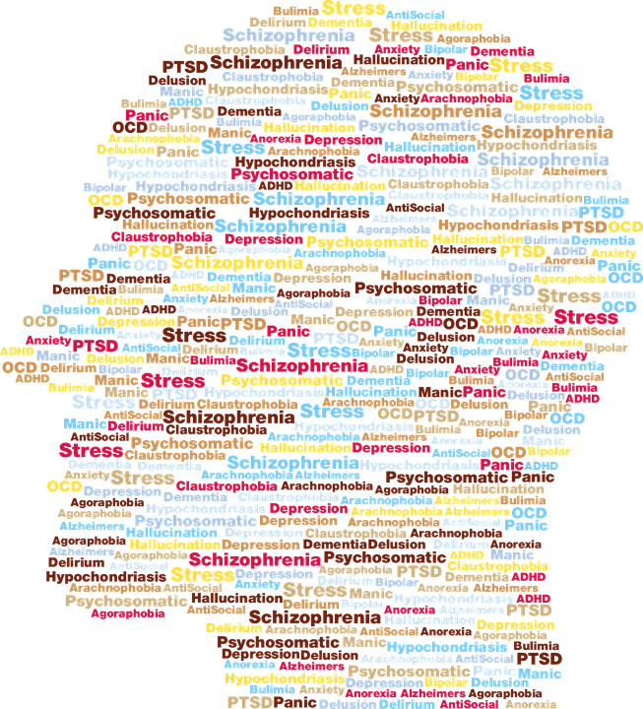
One approach
: Adolescents living in different times
(i.e., adolescent mental health in light of time trend)
Image source: https://pixabay.com/vectors/mental-health-abstract-anatomy-art-3285634/
Open Seminar: Meet a researcher
September 24th 2019

Slide 4
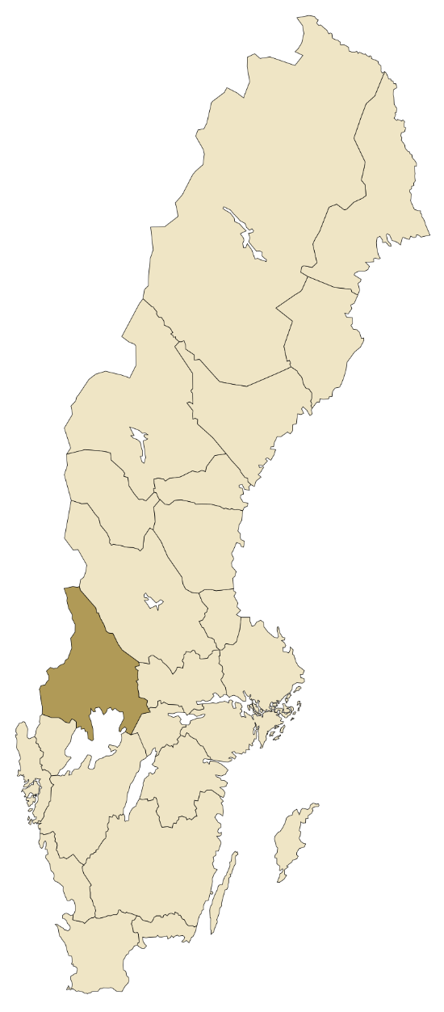
Young in Värmland (YiV)
: hosted by the Centre for Research on Child and Adolescent Mental Health at Karlstad University
(www.kau.se/cfbuph)
: all grade 9 students from all 16 municipalities in Värmland
: every 3 or 4 years between 1988 and 2011, total 8 times
: self-report survey and school/municipality/national-level data
Image source: https://en.wikipedia.org/wiki/V%C3%A4rmland#/media/File:Sverigekarta-Landskap_V%C3%A4rmland.svg
Open Seminar: Meet a researcher
September 24th 2019

Slide 5
Explanation!
Open Seminar: Meet a researcher
September 24th 2019

Slide 6
Explanation!
Change in unemployment rate over time
Worry about family finance
Open Seminar: Meet a researcher
September 24th 2019

Slide 7
Explanation!
Psychosomatic symptoms:
The higher, the more adolescents suffered
Time trend in reality
Time trend after controlling for worry about family finance
***
***
***
***
***
*
***
†
*
Girls
Boys
Note. † p < .10 * p < .05 *** p < .001
Open Seminar: Meet a researcher
September 24th 2019

Slide 8
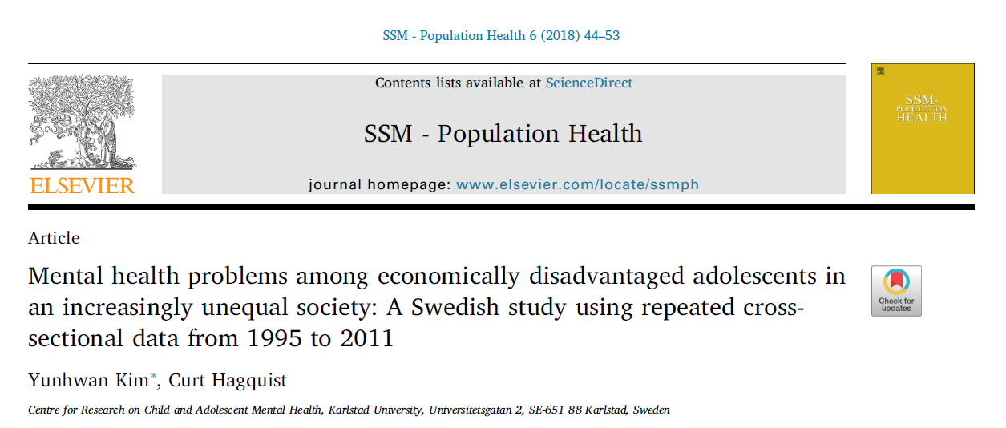
Explanation!
Open Seminar: Meet a researcher
September 24th 2019

Slide 9
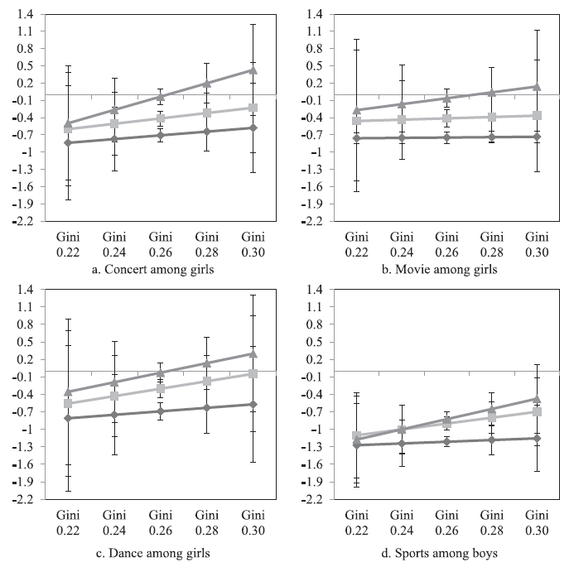
Psychosomatic symptoms:
The higher, the more adolescents suffered
Explanation!
(I could not afford) Several times
(I could not afford) A few times
(I could not afford) No time
Open Seminar: Meet a researcher
September 24th 2019

Slide 10
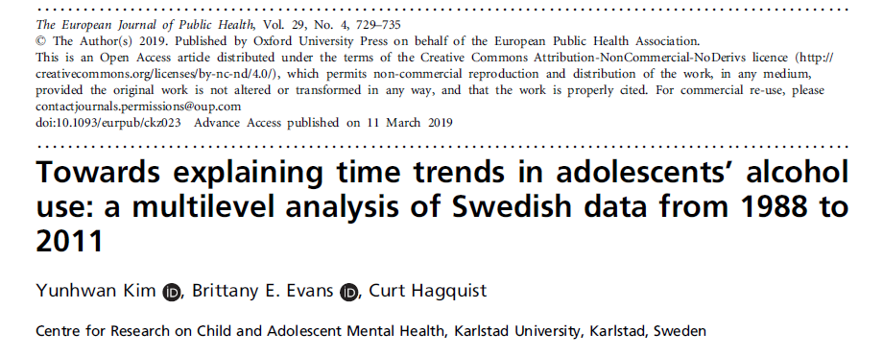
Explanation!
Open Seminar: Meet a researcher
September 24th 2019

Slide 11
Explanation!
Open Seminar: Meet a researcher
September 24th 2019

Slide 12
Explanation!
Open Seminar: Meet a researcher
September 24th 2019

Slide 13
Explanation!
Peer
Parent
Monitoring
Open Seminar: Meet a researcher
September 24th 2019

Slide 14
One approach
: Adolescents living in different times
(i.e., adolescent mental health in light of time trend)
Changes in the society over time (and changes among people therein) are valuable and informative in understanding adolescent mental health
Acculmulation of such information is necessary for helping those who suffer from mental health problems in changing society and preventing them in the first place.
Image source: https://pixabay.com/vectors/mental-health-abstract-anatomy-art-3285634/
Open Seminar: Meet a researcher
September 24th 2019

Slide 15
Thanks!
Center for Research on Child and Adolescent Mental Health: https://www.kau.se/cfbuph
10th anniversary booklet: https://www.kau.se/files/2019-07/CFBUPH%20jubileumsskrift%202009-2019.pdf
Contact: yunhwan.kim@kau.se
Open Seminar: Meet a researcher
September 24th 2019

