Slide 1
Fil. Dr, Sociologisk demografi, Sociologiska institutionen, Stockholms universitet (2014)
Marie Curie postdok forskare, Université catholique de Louvain, Belgium (2016-2017) Postdok forskare, Centrum för forskning om barns och ungdomars psykiska hälsa, Karlstads universitet (dec 2017 - )
Forskning
5 länder, inklusive Sverige, Norge, Kina, Sydkorea och Japan
Samhällsfrågor, t.ex. familjeliv, arbetsliv, familjebildning och separationer, fruktsamhet, uttag av föräldraledighet, migration, samt ungdomars psykiska hälsa och utveckling
Li Ma

Slide 2
Leisure Time Physical Activity and Depressive Symptoms among Adolescents in Sweden
Li Ma^{1,2}, Curt Hagquist^{1,2}, Annette Løvheim Kleppang²
¹Centre for Research on Child and Adolescent Mental Health, Karlstad University, Sweden
² Department of Public Health and Sports Science, Inland Norway University of Applied Sciences, Norway
Sep 24, 2019

Slide 3
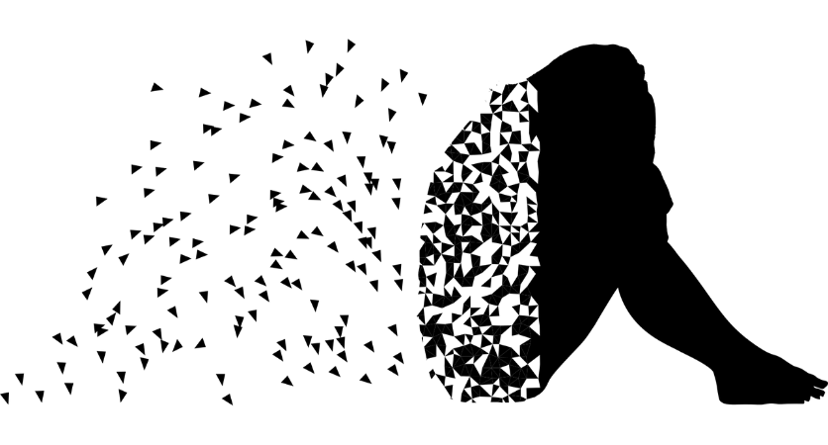
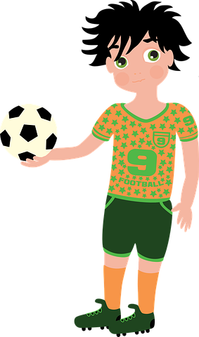
Background
Mental health problems
Physical activity
Girls - depressed, anxious
Gender differences
Boys - physically active

Slide 4
Finland
Denmark
Iceland
Norway
Sweden ?
Nordic countries
Physical inactivity - high risk of emotional problems
(Kantomaa et al. 2008)
(Poulsen et al. 2015)
(Sigfustottir et al. 2011)
Weak association (Kleppang et al. 2017, 2018)

Slide 5
Sweden
- life style, self-esteem, social competence, grades
- smoking, alcohol
(Raustorp et al. 2005, Käll et al. 2014, Wagnsson et al. 2013)
- no evidence for psychosomatic complaints (Wagnsson et al. 2013)
- depressive symptom?

Slide 6
Aim of this study
How is leisure time physical activity associated with the likelihood of feeling depressed?
2. How does the association vary across gender?

Slide 7
Data & Methods
The Children of Immigrants: longitudinal Survey in Four European countries
(CILS4EU – Sweden)
Sample: 4531 students in grade nine, 2012
Logistic regression model
Outcome: Often feeling depressed
Main variable: Physical activity frequency
Other variables: Smoking, future education plan, parents’ education, ethnicity, family structure, gender

Slide 8
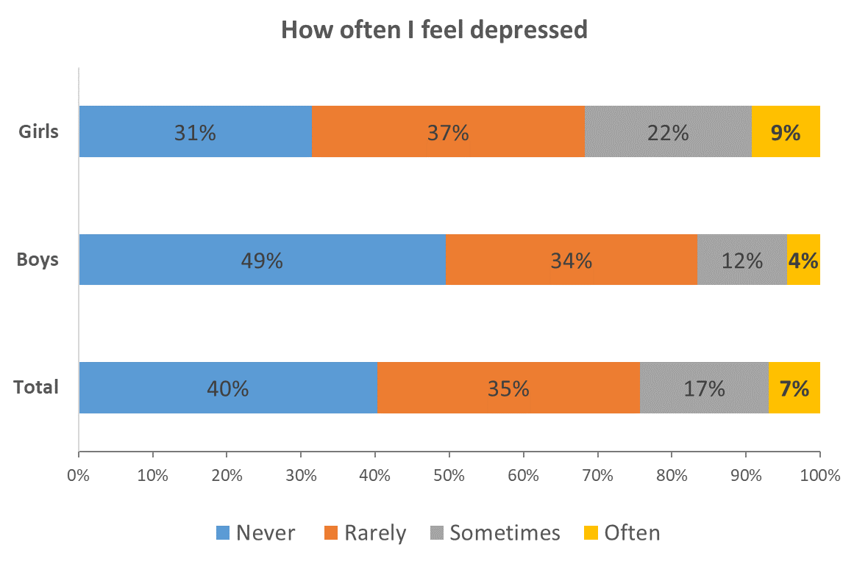
Descriptive statistics (depressive symptom)

Slide 9
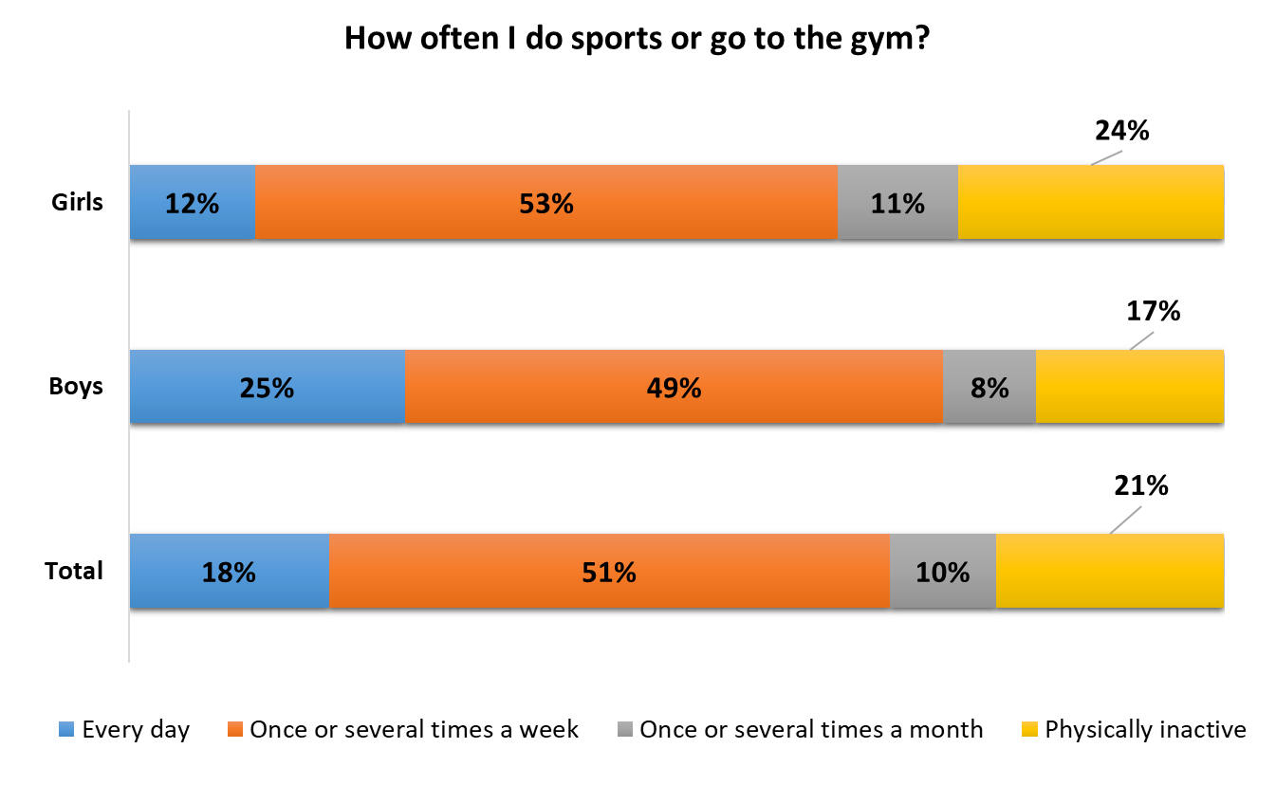
Descriptive statistics (physical activity)

Slide 10
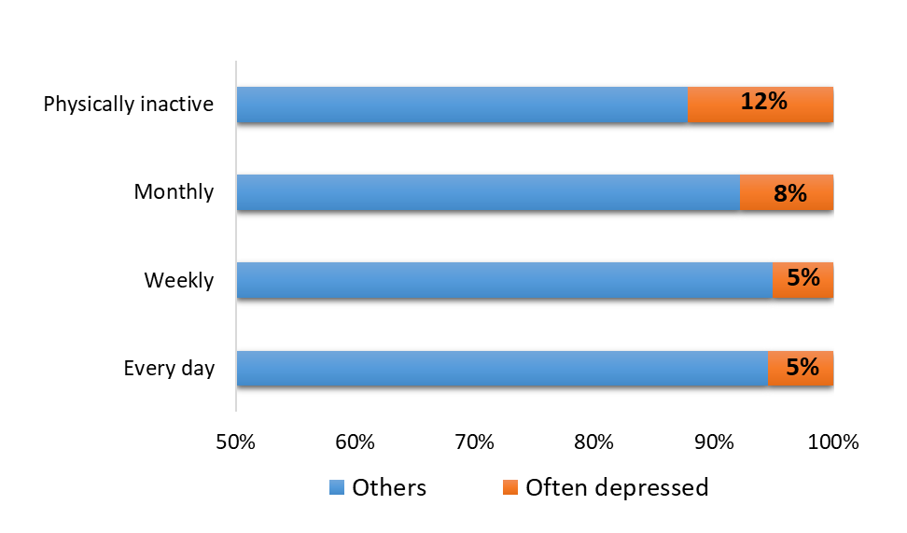
Physical activity & depressive symptom

Slide 11
Results from logistic regression model
Physical activity – often feeling depressed

Slide 12
Figure: Odds ratio of often feeling depressed among adolescents in Sweden, 2012
***
**
Notes:
Chemistry: feel good in body, three factors: eat, work out, sex, evolution
Feeling good dopamine
Working out: less stress hormone
Smoking:

Slide 13
Figure: Odds ratio of often feeling depressed among adolescents in Sweden, 2012
***
***
Notes:
Chemistry: feel good in body, three factors: eat, work out, sex, evolution
Feeling good dopamine
Working out: less stress hormone
Smoking:

Slide 14
Figure: Odds ratio of often feeling depressed among adolescents in Sweden, 2012
***
***
***
Notes:
Chemistry: feel good in body, three factors: eat, work out, sex, evolution
Feeling good dopamine
Working out: less stress hormone
Smoking:

Slide 15
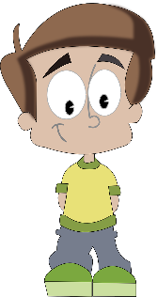
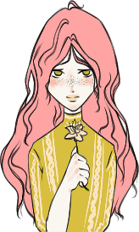
Figure: odds ratio of often feeling depressed by physical activity & gender
Physical inactivity - high risk (boys & girls)
Girls, regular basis ≈ boys, physically inactive
Physically inactive girls call for concern
Notes:
Social media
How did they collect data, boys might not want to show their feelings
Internalized problems, cannot be generalized to externalized problems
Data limitation, denifition of depression varies by time and personality.

Slide 16
Finland
Denmark
Iceland
Norway
Sweden ?
Discussions and conclusion
Physical inactivity - high risk of emotional problems
Weak association

Slide 17
Finland
Denmark
Iceland
Sweden
Norway
Discussions and conclusion
Physical inactivity - high risk of emotional problems
Physical inactivity - high risk
Girls, regular base ≈ boys, physically inactive
Physically inactive girls call for concern
Weak association

Slide 18
Thank you!
li.ma@kau.se

